Slide 1
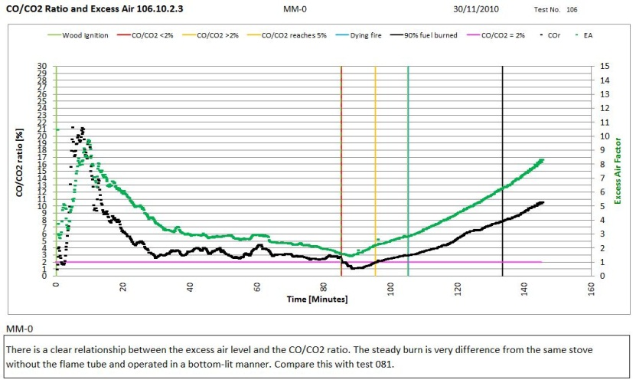

DEVELOPMENT OF A LOW SMOKE MONGOLIAN COAL STOVE
USING A HETEROGENEOUS TESTING PROTOCOL
Crispin Pemberton-Pigott
19th DUE Conference 2011

Slide 2
The problems
Relative to the needs of the three billion people cooking over fires each day, few improved stoves are in use after decades of donor-funded development and promotion.
The products generally are of poor quality and unimpressive performance
The methods used to evaluate stove performance do not readily reveal their advantages which leads to poor product evaluation.
Low performance products are promoted.

Slide 3
What should we measure
(at a minimum)
Measure the carbon-monoxide (CO)
Measure the excess air (EA) in the chimney to arrive at an ‘air demand’ (λ)
Multiply the CO * λ = CO(emission factor)
Do the same for the PM2.5 (smoke particles)
Plot CO(EF) and EA and PM2.5(EF) in real time
Observe carefully

Slide 4
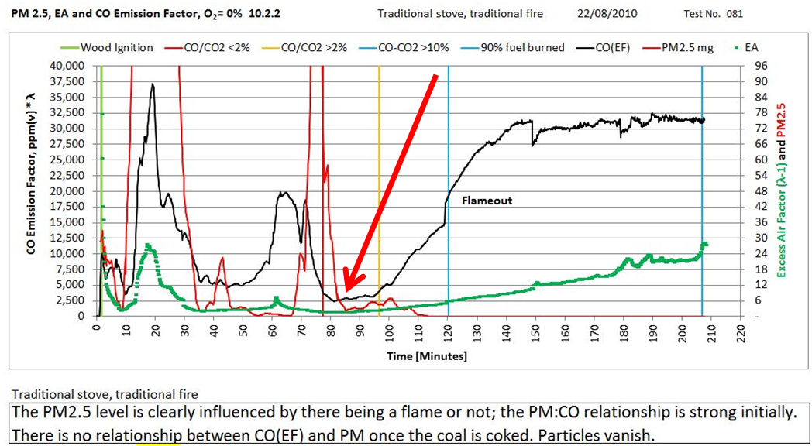
There is a brief period when the stove burns very cleanly with low CO and
low PM2.5 (red arrow). Nearly all stoves have such a moment when conditions are ideal.

Slide 5
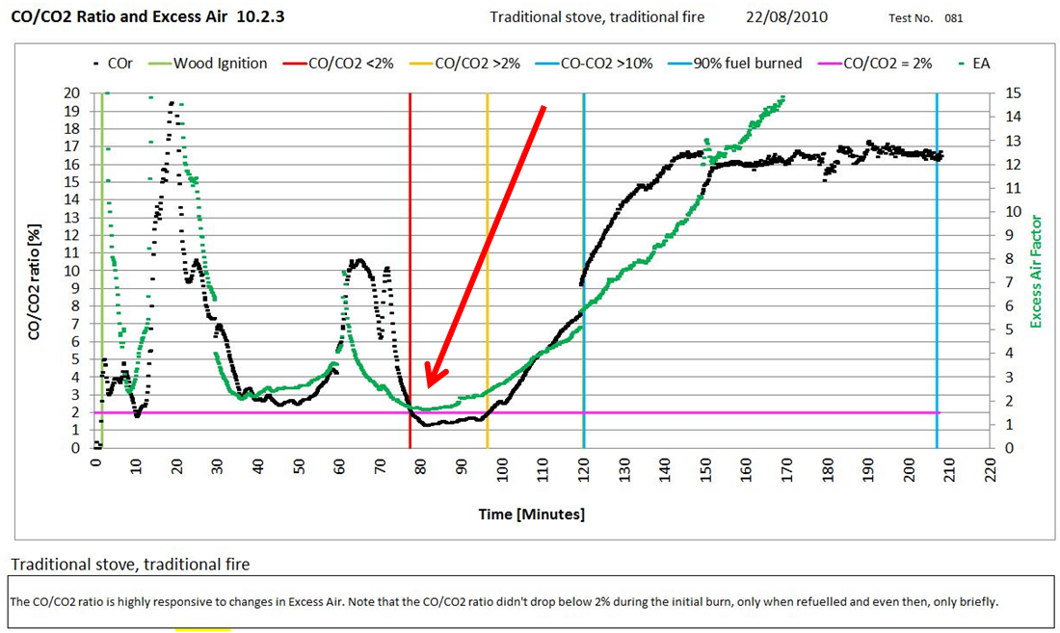
The Excess Air Ratio (EA) had to be under 200% in order for the CO/CO₂ ratio to be under 2%. It did not last long – only 20 minutes. The burn rate was very high at the time.

Slide 6
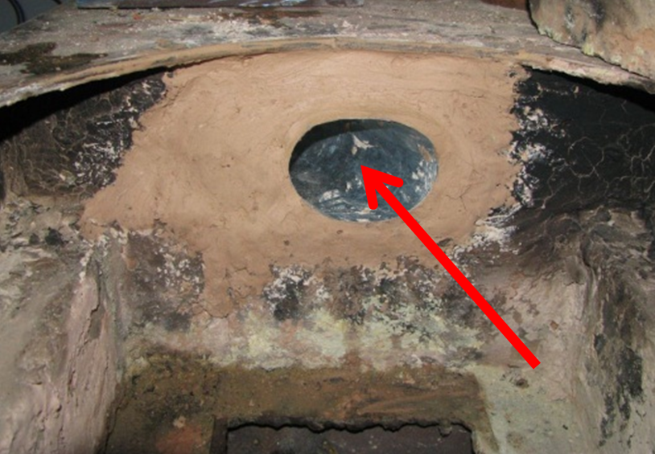
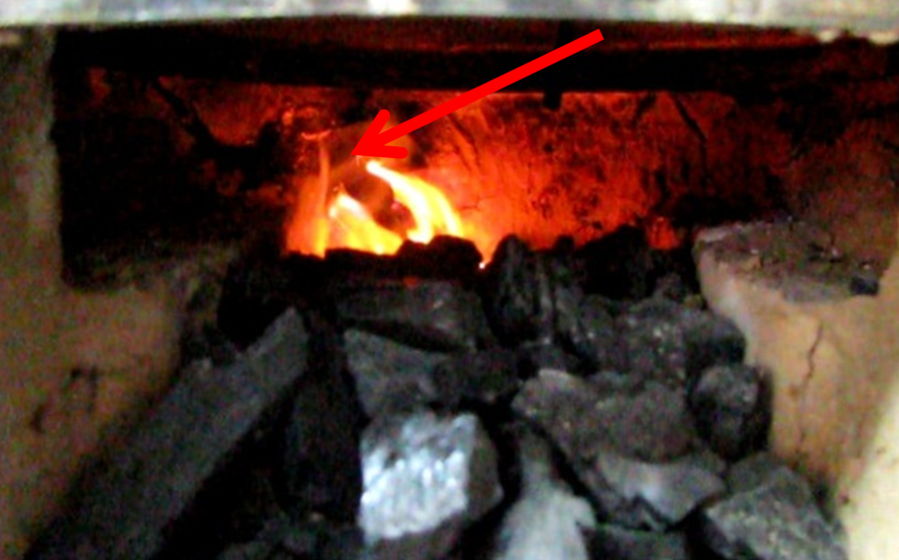
Basa Njengo Mongolia
A version of the South African ‘basa njengo magogo’ fire was made, on it side, in a traditional Mongolian stove with a flame tube added in the back wall.
Flame tube 28 cm long Fire and smoke go in

Slide 7
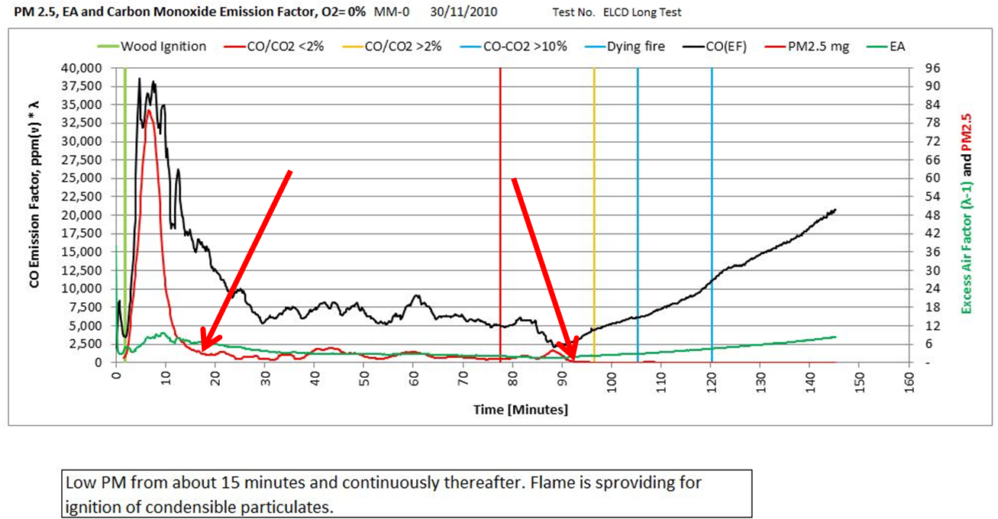
The excess air was much better controlled and the CO(EF) held to a low value
for a much longer time – nearly 2 hours. The combination greatly reduced
the PM2.5 (red line). After coking, the CO(EF) rises but the PM does not.

Slide 8
The difference between the Traditional and ELCD Crossdraft thermal efficiency profiles
was dramatic. By controlling the excess air and allowing the coal to burn slowly from
one end to the other, the thermal efficiency line is nearly flat at 72%, up 1/6th.

Slide 9
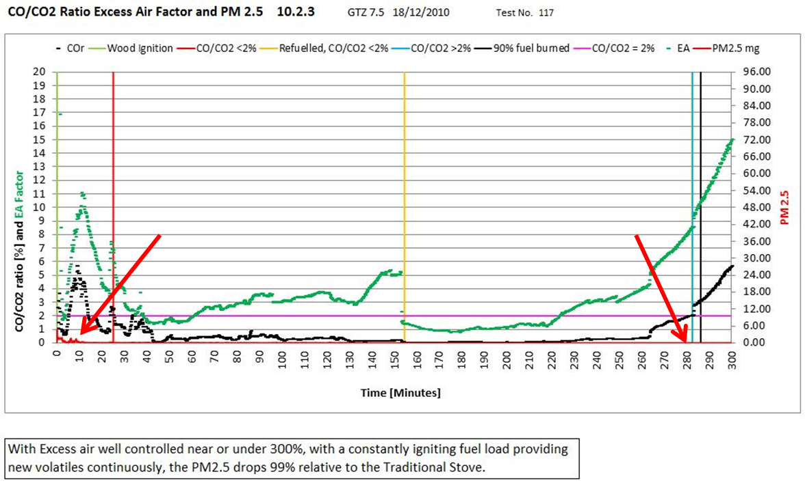
This stove has a hopper mounted so the fuel is supplied continuously and with well
controlled air (green) the PM2.5 almost disappear. The jump in the centre is the stove
being refueling at minute 154. This stove is ‘three nines’ cleaner (1/1000th the PM).

Slide 10
We learned that…
It is possible to burn high volatiles (50%) lignite in a simple natural draft stove if the combustion parameters are carefully set.
The optimum parameters can most readily be found by using a heterogeneous testing protocol, with real time measurements, displayed and calculated in sections of interest.

Slide 11
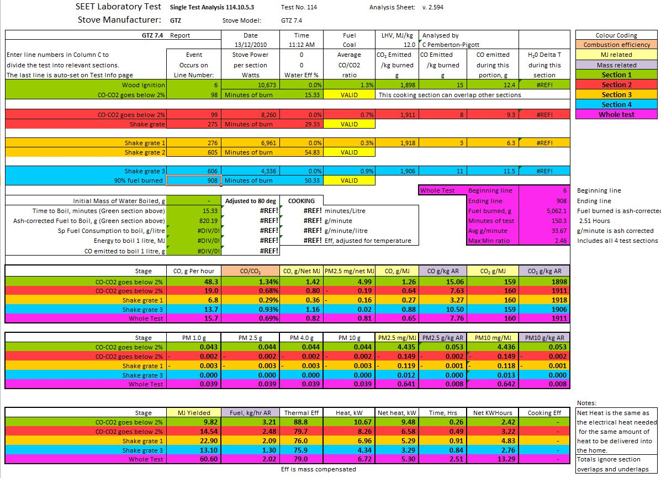

Slide 12
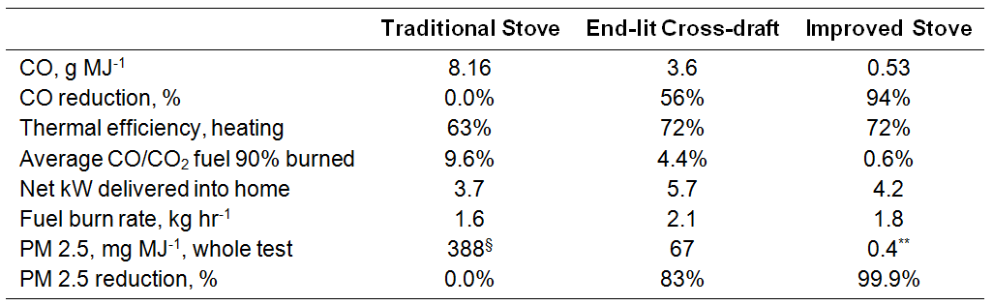
Level of improvement
The numbers include the whole ignition cycle to the point at which 90% of the fuel has burned. The thermal efficiency, power and CO/CO₂ ratio are mass-compensated every ten seconds then summed.

Slide 13
Thanks to…
World Bank Prof Lodoysamba
Asian Dev Bank Prof Tseyen-Oidov
SEET Laboratory Altangadas (Eng.)
SeTAR Centre NUM
Ulaanbaatar CAP Nuclear Research Lab
MMRE (Gov’t) Univ of JHB
GIZ Mongolia (used to be GTZ) Dalkia Consulting

